Slide 1

DELIVERY OPERATION ANALYSIS
Client:
Sabores Ibericos Multinational Food Chain
Prepared by
Group B Nebiant Interns

Slide 2

PRESENTATION STRUCTURE
Slide 1 – Project Topic
Slide 2 – Presentation structure
Slide 3 Business Problem
Slide 4 – Dataset Overview
Slide 5 – Data cleaning Process
Slide 6 – Project Objective
Slide 7 - City by Cost Analysis
Slide 8 – Store by CWT Analysis
Slide 9 – Distance CPO Analysis
Slide 10 - Correlation Heatmap
Slide 11 - Feature Importance
Slide 12 - Machine Learning Model Acuracy
Slide 13 – Model Performance
Slide 14 – Final Rank
Slide 15 – Recommendation
Slide 16 - Conclusion

Slide 3
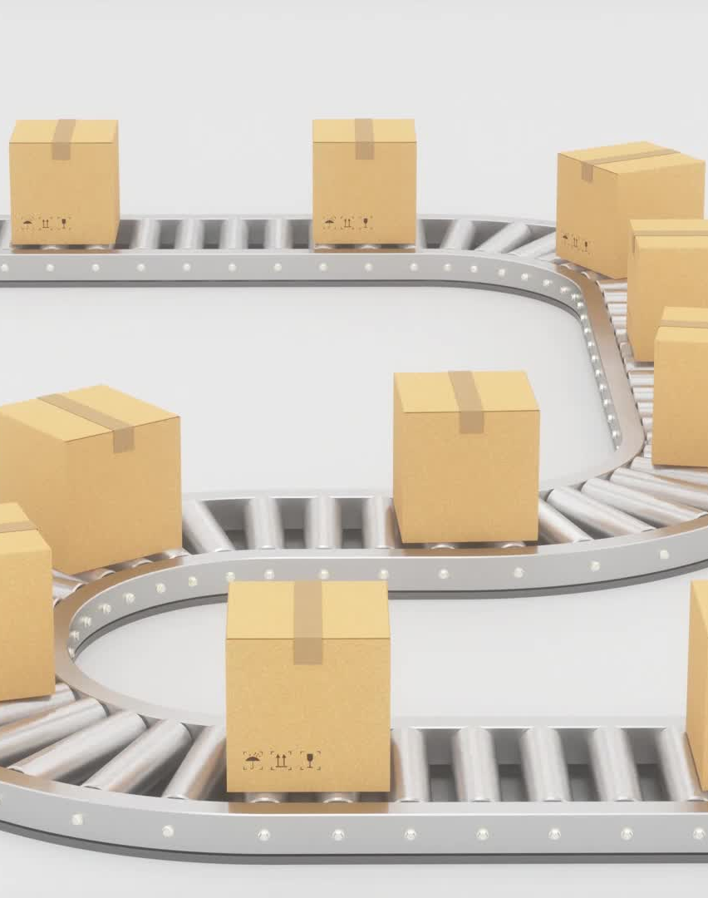
BUSINESS PROBLEM
Over the past several months, the company has experienced increasing delivery cost and longer courier waiting times across multiple cities.
These inefficiencies may be affecting operational performance, delivery speed and profitability. The organization needs to understand the key factors driving high cost per order (CPO) and courier waiting time in order to improve delivery efficiency and optimize strategies

Slide 4

DATASET OVERVIEW
Dataset includes operational delivery data with the following variable:
City
Order Id
Order date
Store code
Basket size
delivery fee
Cost per Order
Delivery distance
Courier waiting time

Slide 5

DATA CLEANING PROCESS
The dataset was cleaned using Power BI Query through the following:
Import the dataset and promoted the first row to header
Delete duplicate courier waiting time (mins) so we have just one column
Renamed columns for consistencies and easier visualization
Convert column to appropriate data type
Remove duplicate records based on order
Handle missing values by filtering of replacing null where necessary
Standardize city and store names to ensure grouping

Slide 6
PROJECT OBJECTIVE
The objective of this analysis is to identify the key factors contributing to high delivery costs and courier delays by analyzing historical order-level data

Slide 7
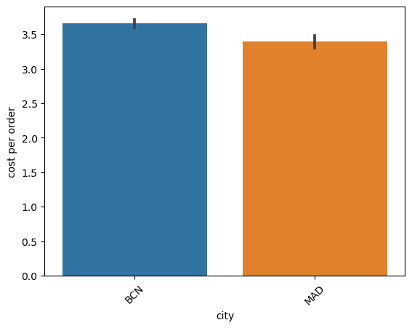
City vs Cost Analysis
Analysis shows that BCN has a higher average cost per Order compared to MAD.
Deliveries to Becelona are generally more expensive for the company

Slide 8
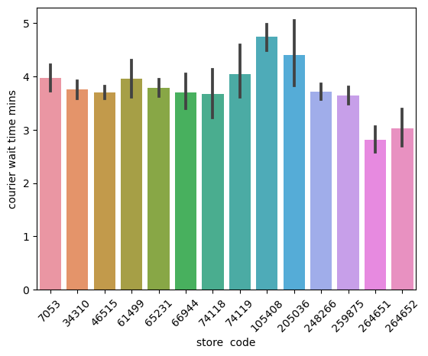

Store by Courier wait time Analysis
This identifies inefficient stores like store105408. It caused the highest courier delays. This help operation teams to investigate specific store.

Slide 9
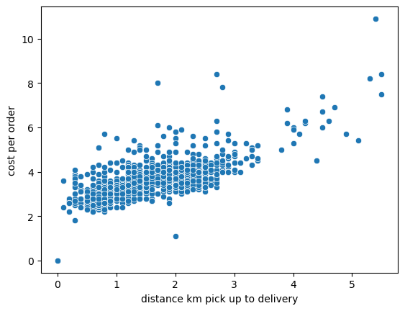
Distance vs Cost per order
Longer deliver distances significantly increase delivery cost.
This supports distance based pricing strategies

Slide 10
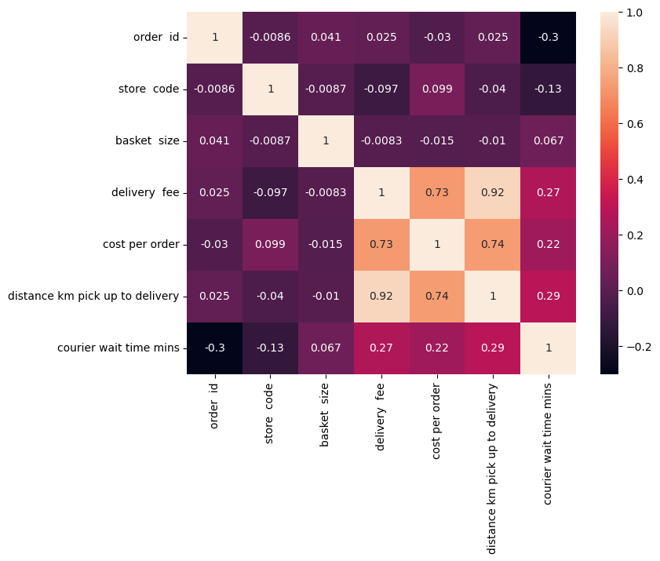
Correlation Matrix
Cost Per Order : Strongly driven by distance 0.74, moderately affected by courier waiting time 0.06 and basket size has no effect -0.02
CWT: weakly affected by Distance(0.29) and mostly independent of basket size.
Basket size: no effect on either cost or waiting time

Slide 11
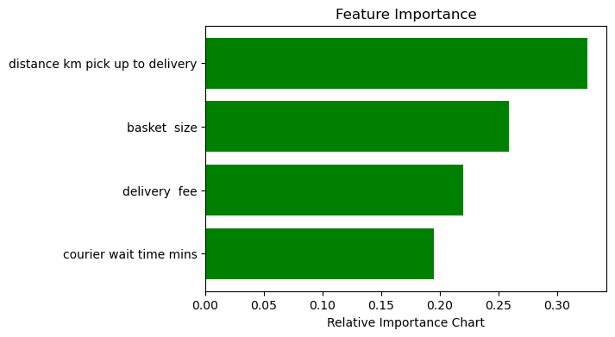
Feature Importance Chart
Distance (km pick up to delivery) – most important – 0.32. is the strongest predictor of high delivery cost. Main driver for expensive order
Basket size 0.26 larger order increases delivery complexity
Delivery cost 0.22 fees are standardize and not proportional to real operational cost
Courier waiting time 0.19 is the least influential among the four variables

Slide 12
Machine Learning Model Analysis
We evaluate seven popular machine learning classifiers on our dataset using standard performance metrics; Accuracy, Precicion, Recall, F1 Score and AUC/ROC.
The goal was to find the model that best balance predicting correctly while minimizing missed case(false negative) and false alarms (False positive)

Slide 13

MODEL PERFORMANCE SUMMARY
Model Accuracy Precision F1-Score AUC/ROC Recall
0 SVC 0.74 0.74 0.68 0.73 0.64
1 RFC 0.77 0.75 0.75 0.77 0.75
2 LR 0.72 0.70 0.68 0.72 0.66
3 XGBC 0.79 0.76 0.77 0.79 0.78
4 SGDC 0.74 0.78 0.66 0.72 0.58
5 GNB 0.74 0.77 0.67 0.72 0.59
6 DTC 0.72 0.68 0.70 0.72 0.72

Slide 14
Final Ranking (Overall Performance)
XGBoost XGBC – Best
Random Forest Classifier (RFC) –second best
SVC/GNB –Moderate
LR/DTC/SGDC - Lower

Slide 15

Recommendations
Assign orders to the nearest store or courier
Improve route optimization system
Use better packaging or batching system for large order
Notify couriers only when orders are ready
Introduce performance monitoring for slow store
Integrate predictive models for operational planning which will allow company to prevent problems before they occur.
Recommended Model for Deployment is XGBoost

Slide 16

Conclusion
This project shows that distance from store to customer and size of the order are the biggest drivers of cost. Delivery fees and courier waiting time also matter, but less so.

Slide 17

THANK YOU FOR LISTENING...
PRODUCED
BY
GROUP B INTERNS

